Slide 1

Running with Data
Sara Hayden | MSDS Practicum II

Slide 2
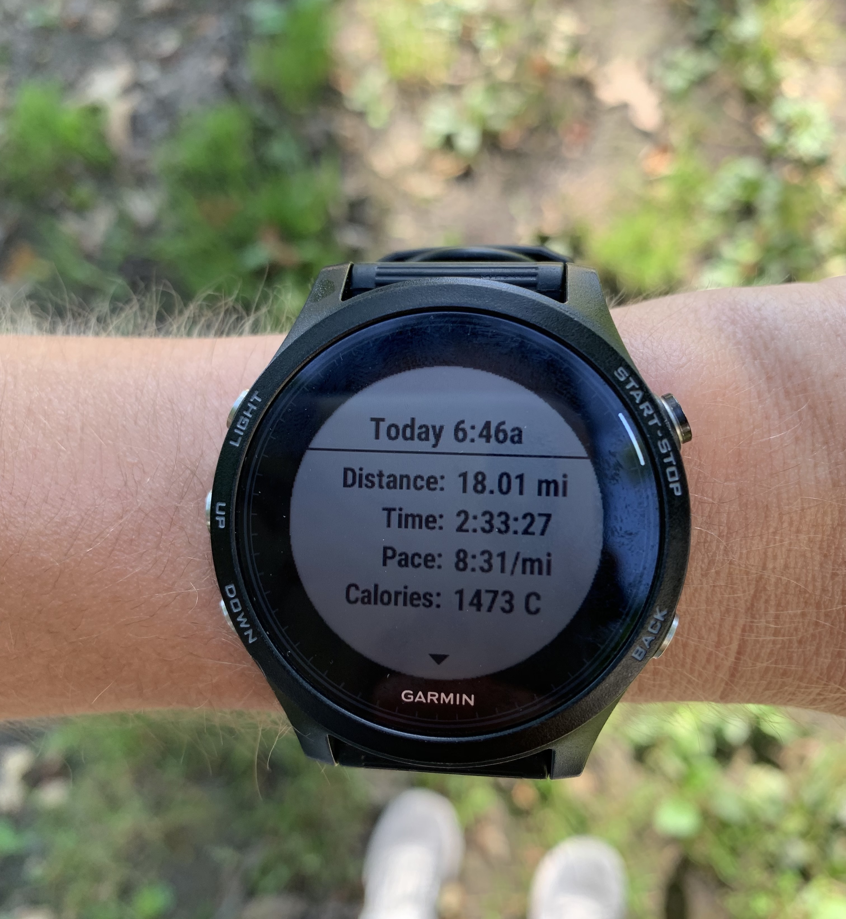
Can I predict my marathon time based on my previous training data?
As a marathon runner I am constantly chasing my next Personal Best (PB) time
What can my data from my smart watch tell me that will help me improve my time
While training is there a way I can gauge if I’m on track to hit that PB?
What other insights can I gather from the information gathered from my smart watch?

Slide 3
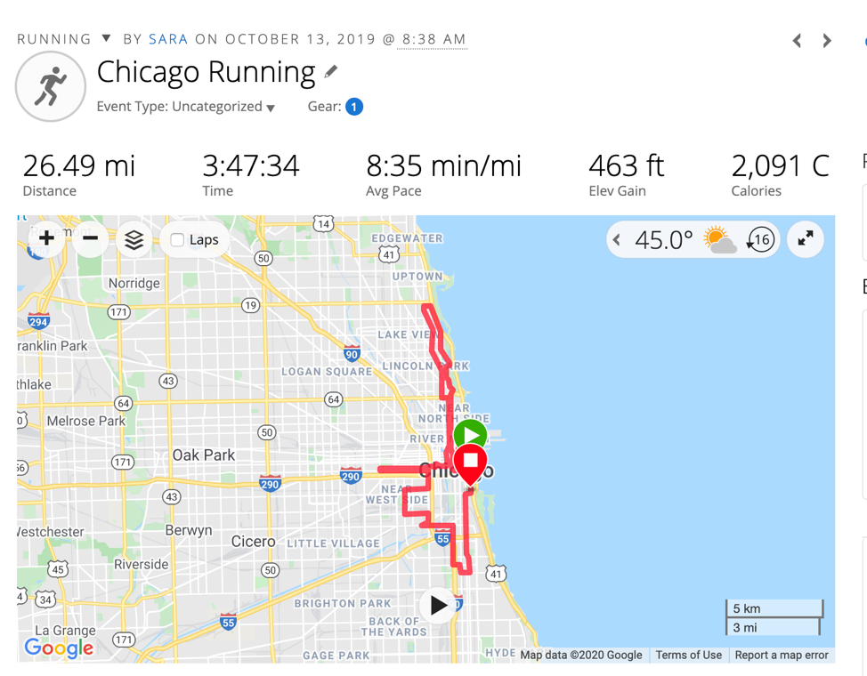
Data
Collected from my Garmin Forerunner Smart Watch
121 logged activities, and 28 descriptive columns
May 3rd to October 20th in 2019

Slide 4
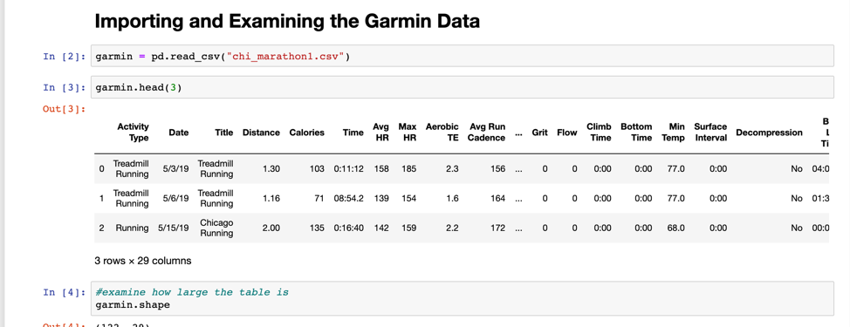
Python for Analysis
Jupyter notebook and using DataFrames and grouping operations in Pandas to examine performance across the training time frame
For visualizations I incorporated the seaborn feature of Matplotlib for comparisons, as well as heatmaps and K-means clustering

Slide 5
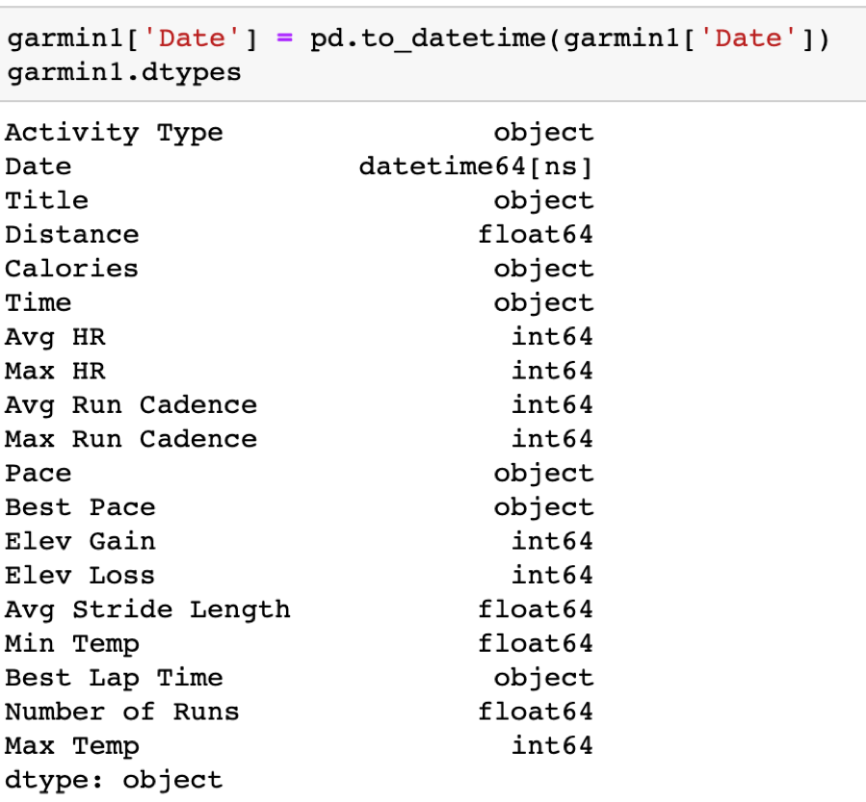
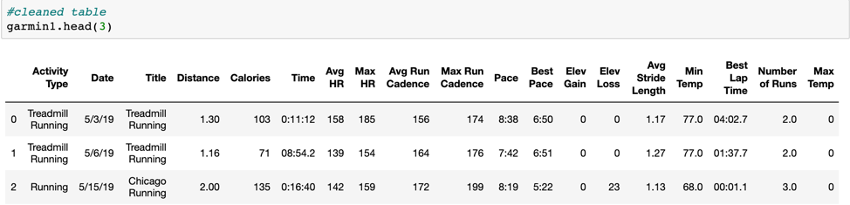
Data Cleaning
Removed several columns and null data
Changed variable types in the Dataframe

Slide 6
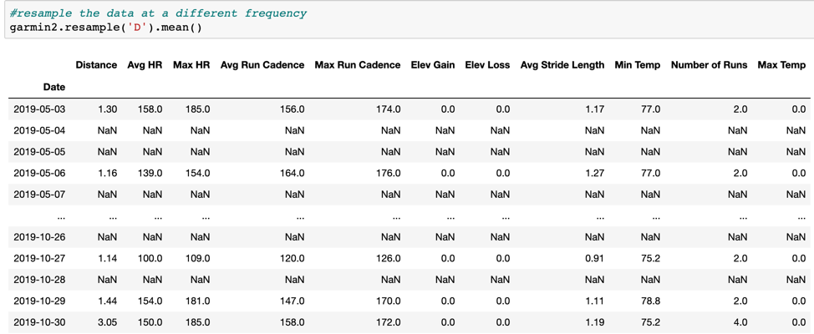
Time Series Indexing
Identify trends in Distance and Time for each day

Slide 7

Descriptive Statistics

Slide 8
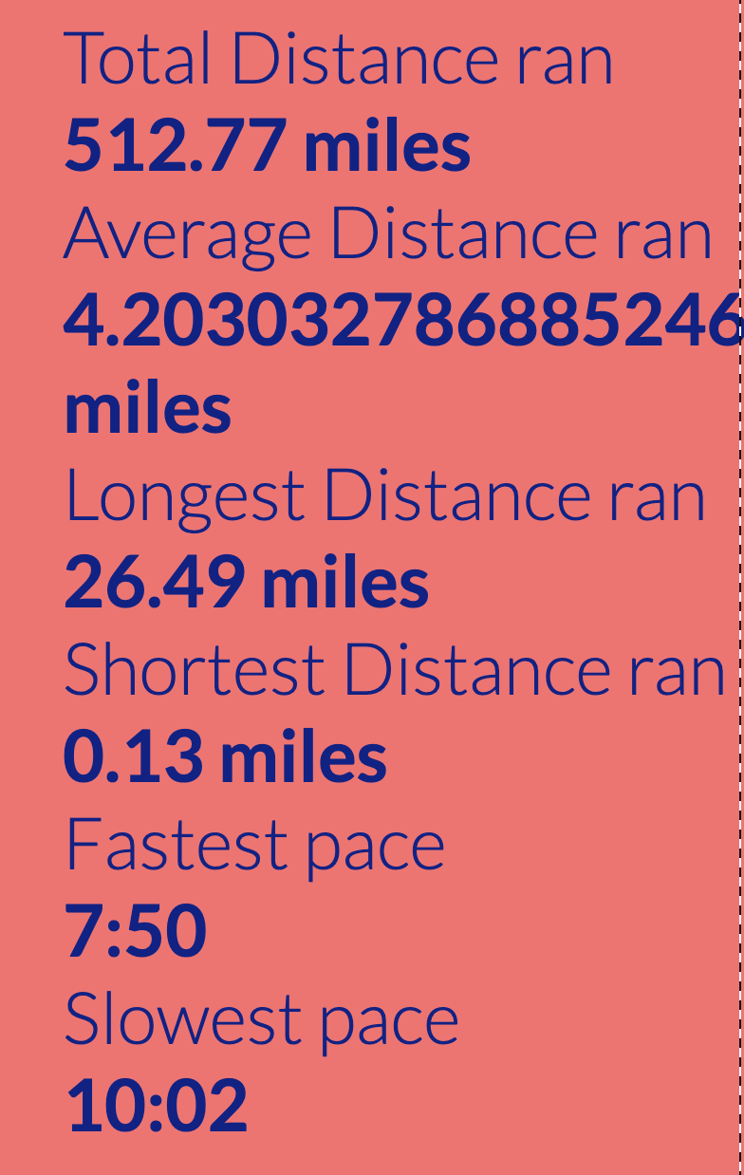
Overall Mileage
Important for: Shoe degradation and Personal Best Time
Running shoes are generally good for 300 - 500 miles, depending on the shoe and the use, this is important for preventing injury

Slide 9
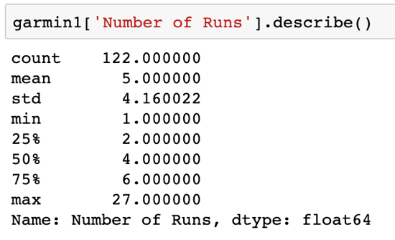
Overall Mileage
More miles, the better PB Times
“doubling up and running in a depleted state can boost fat-burning, train the body to use glycogen more efficiently, and stimulate mitochondria production (more mitochondria can delay fatigue) (Marshal, 2019)

Slide 10
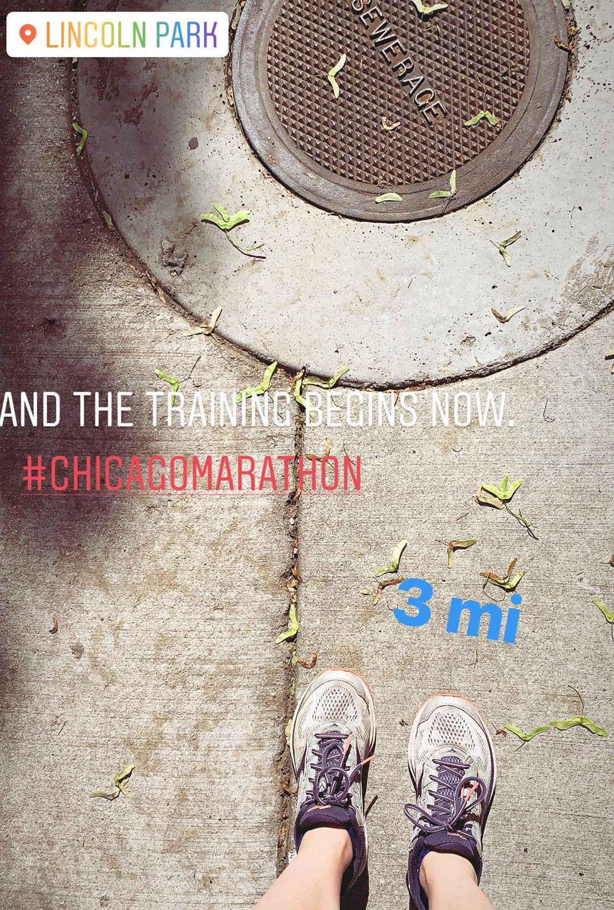
Cardiovascular fitness level
Helps determine if you’re becoming stronger and building endurance
Heart Rate is indication of if you’re becoming more cardiovascularly fit

Slide 11
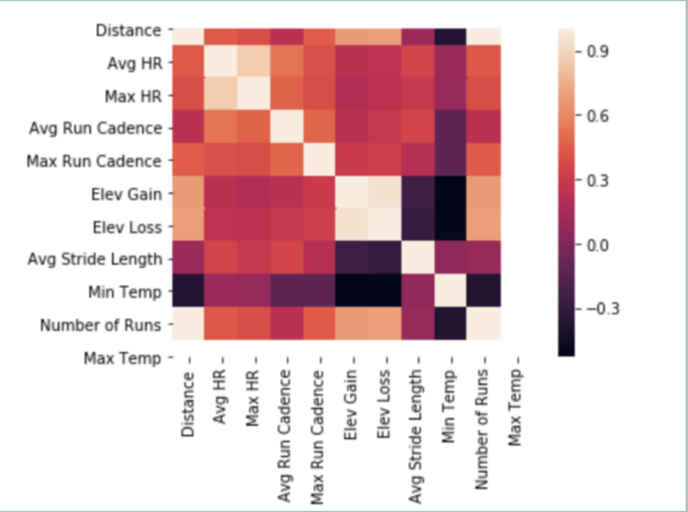
Heat Map
Correlation between distance and heart rate
The color palette on the side shows the amount of correlation between the two variables
The lighter in shade represents a high correlation and the darker shade a low correlation

Slide 12
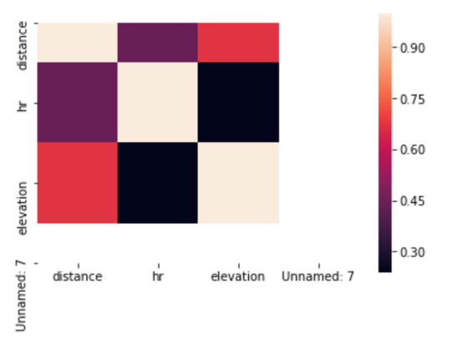
Heat Map
Distance and hr are highlighted in orange, showing that they have an average correlation between each other
Indicates that I had a steady increase in cardiovascular fitness as I trained for the marathon

Slide 13
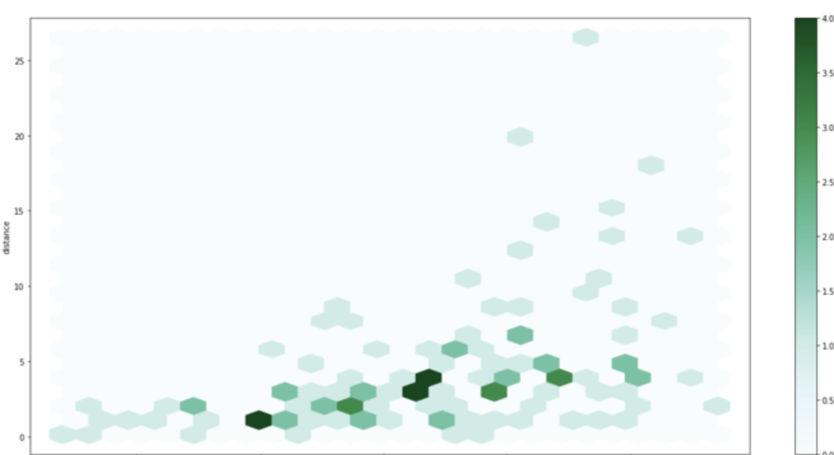
Hexbin Plot
Represents the relationship between distance and heart rate throughout the months of training
Color indicates the number of points, the darker in color the more points.
Looking at the graph we see the lower mileage times have darker points as they are more consistently ran, making my heart rate more consistent over time.

Slide 14
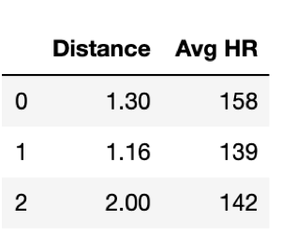
Clustering with K-Means
Examining the relationship between Distance and Heart Rate

Slide 15

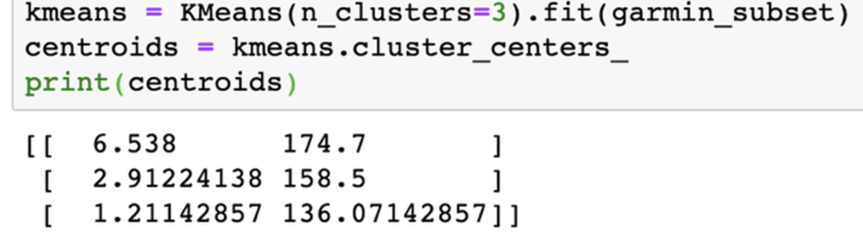
Creating the Clusters

Slide 16
K-Means graph
Represents subgroups of distances with an average heart rate associated with it based on the conditions of the K means clustering algorithm
There are no labels in this graph as K means clustering is an unsupervised learning technique

Slide 17
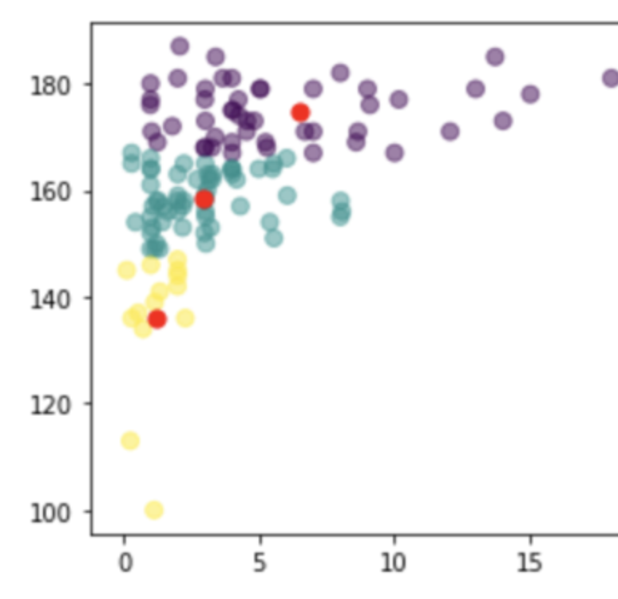
K- Means Graph
For interpreting the graph, the center of each cluster in red denotes the mean of all observations belonging to that cluster
The observations that belong to a given cluster are closer to the center of that cluster, in comparison to the center of the other clusters

Slide 18
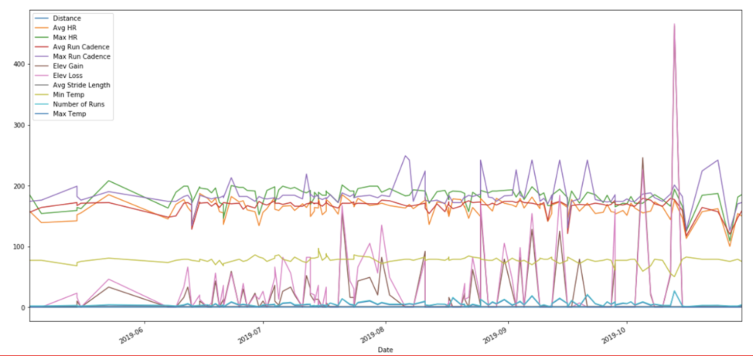
Overview of Data

Slide 19
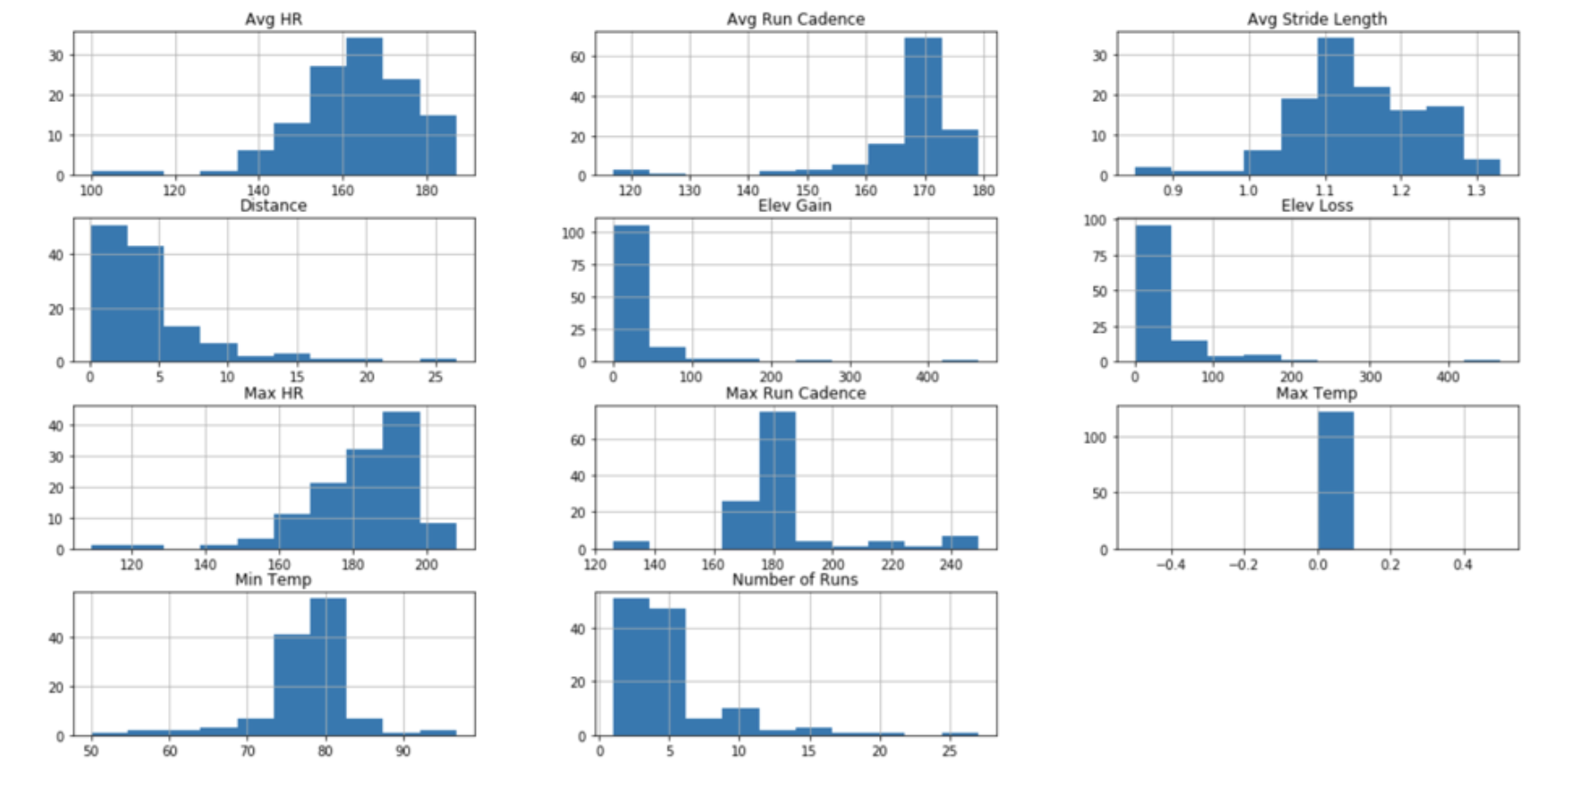

Slide 20
Predicting A Marathon Time

Slide 21


Approach
Pete Riegel’s formula for predicting marathon times published in Runner’s World in August of 1977
The formula:
T2 = T1 x (D2/D1) 1.06
Where:
T1 = Given Time D1 = Given Distance D2 = Distance to predict a time for
T2 = calculated Time for D2
This formula implied that your overall pace will slow down as you run longer distances

Slide 22
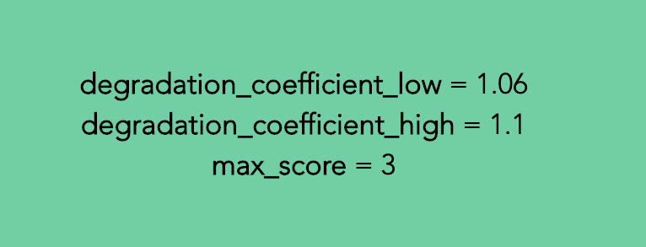

Boundaries
Boundary values for the degradation coefficient are 1.06 as the fastest time and 1.10 for the slowest time
Score for elevation and distance is set as 0% for the lowest value and 3% as the highest value

Slide 23
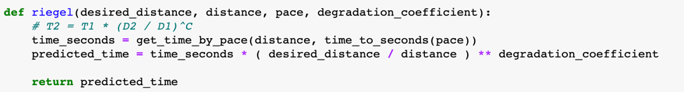
Riegel Calculation

Slide 24
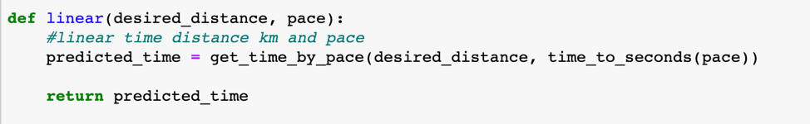
Why use Riegel over a linear function?
Linear predicted times were a bit off
While linear does provide boundary values that help for estimation, Riedel’s formula accounts for more factors to get a more accurate representation

Slide 25
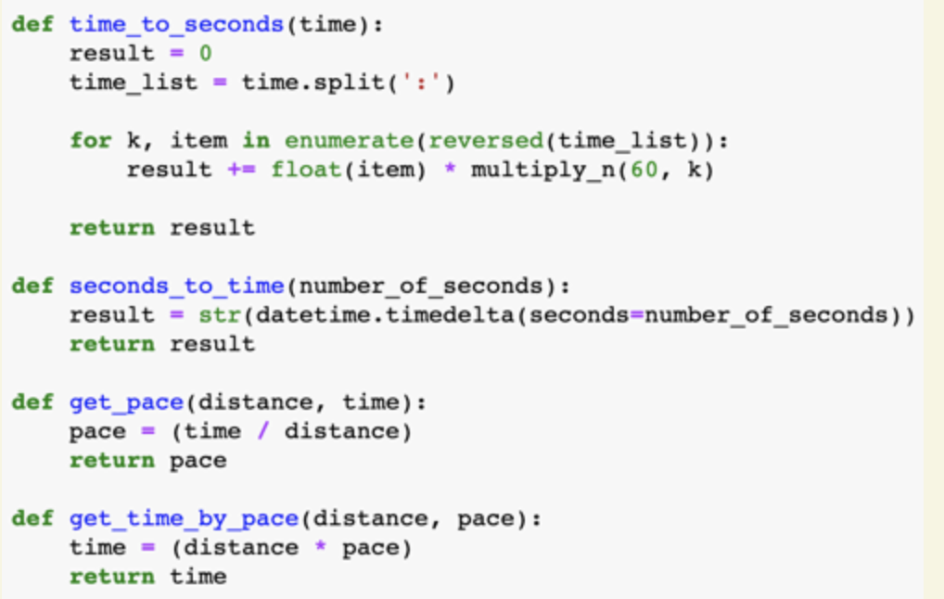
Working with Time

Slide 26
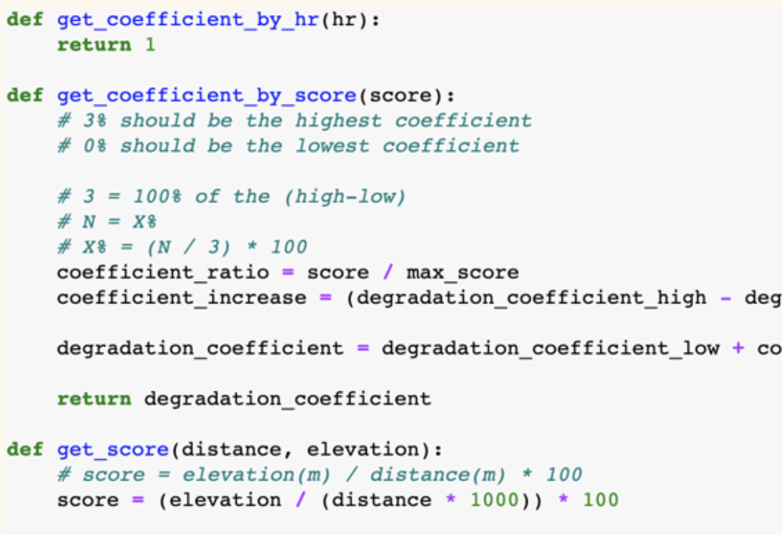
Coefficient Score

Slide 27

Results

Slide 28
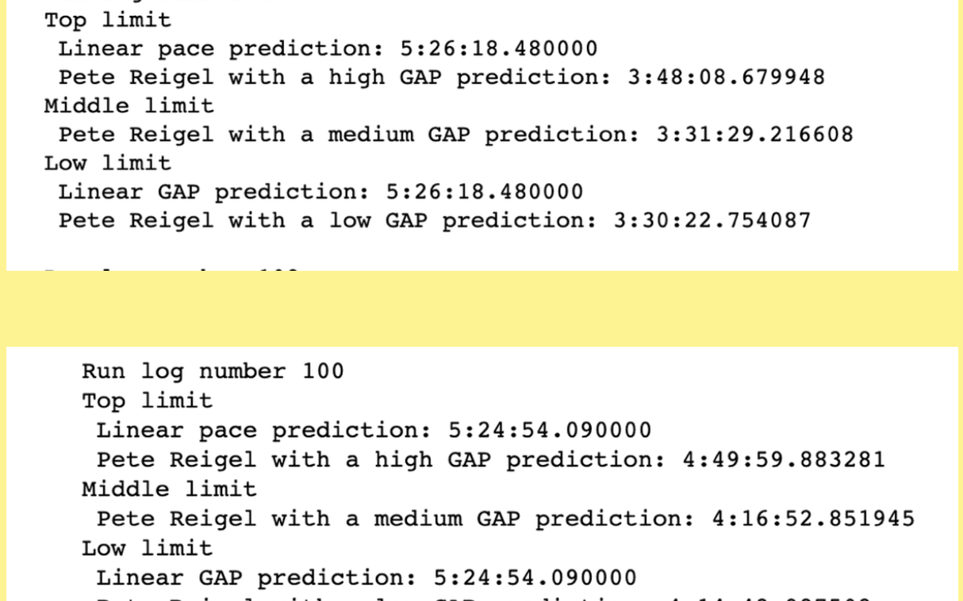

Slide 29


Findings
Run Log number 107’s Pete Riegel with a High Gap prediction most accurately matched my Marathon time
I ran the Chicago Marathon in 3 hours and 47 minutes and the predicted time was 3 hours and 48 minutes
Each run log projected slightly different times, some of which were way off, for example Run Log number 100 predicted a Pete Riegel with a high GAP time of 4 hours and 49 minutes

Slide 30
Next Steps
Adding Strava data of other activities completed during the week that could influence performance as well as examining temperature and mileage per week

Slide 31
Average Speed and Pace Calculator
Average Speed Calculation
sec_to_hr = 1/3600 # 3600 seconds in 1 hour min_to_hr = 1/60 # 60 minutes in 1 hour
time_hrs = time_in_hr + (time_in_m*min_to_hr) + (time_in_s*sec_to_hr) # Total time in hours
av_speed = miles/time_hrs # Total time in miles
Average Pace Calculation
pace_dist = 1 #1mile
pace_time_hr = round(pace_dist/av_speed, 2)
pace_time_min = round(pace_time_hr * 60, 2)
pace_time_sec = round(pace_time_min % 1,2) * 60

Slide 32
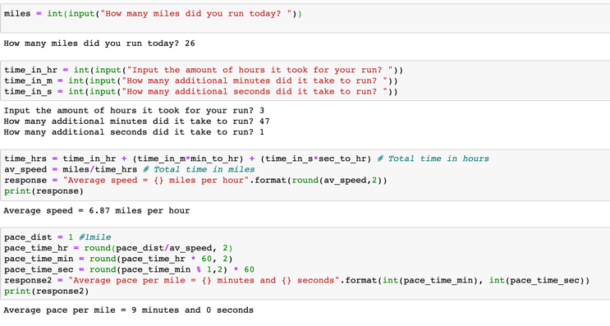

Slide 33

You can view more of this project at https://bethhayden1996.wixsite.com/shayden/descriptive-analysis Github repo located https://github.com/sbhayden/RunningwithData

Slide 34
References
#84 Hexbin plot with matplotlib. (2017, October 4). Retrieved from https://python-graph-gallery.com/84-hexbin-plot-with-matplotlib/
Gaidus, A. (n.d.). Race Results Part 2 - Analyzing and Visualizing Finish Times. Retrieved May 2, 2020, from http://andrewgaidus.com/Analyzing_Race_Results_Part_2/
Gruber, K. (n.d.). Marathon Training: Heart Rate Training and Monitoring. Retrieved May 2, 2020, from https://www.thepittsburghmarathon.com/Blog-Item-Marathon-Training-Week-14-Heart-Rate-Training-and-Monitoring
pandas development team. (n.d.). Time series / date functionality. Retrieved May 2, 2020, from https://pandas.pydata.org/pandas-docs/stable/user_guide/timeseries.html
Runner’s World. (2013, July 15). RW’s Race Time Predictor. Retrieved from https://www.runnersworld.com/uk/training/a761681/rws-race-time-predictor/

